Slide 1
INTRODUCTION TO DATA SCIENCE
UNIT – I
DATA TYPES & COLLECTION

Slide 2
RESOURCES
TEXT BOOKS:
1.Pang-Ning Tan, Michael Steinbach, Vipin Kumar, Introduction to Data Mining, Pearson Education Inc.
2. Han, Jiawei, Jian Pei, and Micheline Kamber, “Data mining: concepts and techniques”, 3 rd Edition, Elsevier, 2011.
3. Jure Leskovec, Anand Rajaraman, Jeffrey D. Ullman, Mining of Massive Datasets, Cambridge University Press
4. K G Srinivas ,G M Siddesh “Statistical programming in R”, Oxford Publications.
REFERENCE BOOKS:
1. Brain S. Everitt, “A Handbook of Statistical Analysis Using R”, Second Edition, 4 LLC, 2014.
2. Dalgaard, Peter, “Introductory statistics with R”, Springer Science & Business Media, 2008.
3. Samir Madhavan, “Mastering Python for Data Science”, Packt, 2015.
4. Paul Teetor, “R Cookbook, O’Reilly, 2011.

Slide 3
UNIT-I DATA TYPES & COLLECTION
Types of Data: Attributes and Measurement, What is an Attribute?, The Type of an Attribute, The Different Types of Attributes, Describing Attributes by the Number of Values, Asymmetric Attributes, Binary Attribute (Pg.No:22-29, Text Book-1), Nominal Attributes, Binary Attributes, Ordinal Attributes, Numeric Attributes, Discrete versus Continuous Attributes (Pg. No. 39-44, Text-2), Types of Data Sets, General Characteristics of Data Sets, Record Data, Transaction or Market Basket Data, The Data Matrix, The Sparse Data Matrix, Graph Based Data, Graph- Based Data, Ordered Data. Handling Non-Record Data, Data Quality, Measurement and Data Collection Issues, Precision, Bias and Accuracy. (Pg. No. 29-39, Text-1)

Slide 4
GETTING TO KNOW YOUR DATA
Real-world data are typically noisy, enormous in volume (often several gigabytes or more), and may originate from a hodgepodge of heterogenous sources.
Knowledge about your data is useful for data preprocessing, which is the first major task of the data mining process.
What are the types of attributes or fields that make up your data?
What kind of values does each attribute have?
Which attributes are discrete, and which are continuous-valued?
What do the data look like?
How are the values distributed?
Are there ways we can visualize the data to get a better sense of it all?
Can we spot any outliers?
Can we measure the similarity of some data objects with respect to others?
Gaining such insight into the data will help with the subsequent analysis.

Slide 5
Types of attributes include nominal attributes, binary attributes, ordinal attributes, and numeric attributes.
Basic statistical descriptions can be used to learn more about each attribute’s values.
Given a temperature attribute, for example, determine its mean (average value), median (middle value), and mode (most common value).
These are measures of central tendency, which give us an idea of the “middle” or center of distribution.
Knowing such basic statistics regarding each attribute makes it easier to fill in missing values, smooth noisy values, and spot outliers during data preprocessing.
Knowledge of the attributes and attribute values can also help in fixing inconsistencies incurred during data integration.
Plotting the measures of central tendency shows us if the data are symmetric or skewed.
Quantile plots, histograms, and scatter plots are other graphic displays of basic statistical descriptions can all be useful during data preprocessing.

Slide 6
DATA
Type of Data : Data sets differ in a number of ways. For example, the attributes used to describe data objects can be of different types-quantitative or qualitative.
Data sets may have special characteristics; e.g., some data sets contain time series or objects with explicit relationships to one another. Not surprisingly, the type of data determines which tools and techniques can be used to analyze the data.
A data set can often be viewed as a collection of data objects. Other names for a data object are record, point, vector, pattern, event, case, sample, observation, or entity.
In turn, data objects are described by a number of attributes that capture the basic characteristics of an object, such as the mass of a physical object or the time at which an event occurred.
Other names for an attribute are variable, characteristic field, feature, or dimension.

Slide 7
Types of Data
Example: Student Information. Often, a data set is a file, in which the objects are records (or rows) in the file and each field (or column) corresponds to an attribute. Table shows a data set that consists of student information. Each row corresponds to a student and each column is an attribute that describes some aspect of a student, such as grade point average (GPA) or identification number (ID).

Slide 8
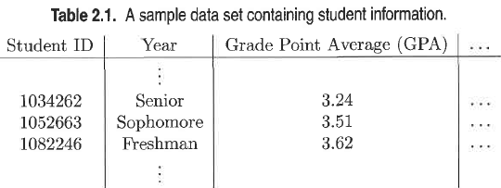
Although record-based data sets are common, either in flat files or relational database systems, there are other important types of data sets and systems for storing data.

Slide 9
Data Objects and Attribute Types
Data sets are made up of data objects.
A data object represents an entity—in a sales database, the objects may be customers, store items, and sales; in a medical database, the objects may be patients; in a university database, the objects may be students, professors, and courses.
Data objects are typically described by attributes.
Data objects can also be referred to as samples, examples, instances, data points, or objects.
If the data objects are stored in a database, they are data tuples.
The rows of a database correspond to the data objects, and the columns correspond to the attributes.

Slide 10
Attributes and Measurement
What Is an attribute?
Definition 1: An attribute is a property or characteristic of an object that may vary; either from one object to another or from one time to another.
For example, eye color varies from person to person, while the temperature of an object varies over time.
Note that eye color is a symbolic attribute with a small number of possible values {brown, black, blue, green, hazel, etc.},
Temperature is a numerical attribute with a potentially unlimited number of values.
At the most basic level, attributes are not about numbers or symbols.
However, to discuss and more precisely analyze the characteristics of objects, numbers or symbols are assigned to them.
To do this in a well-defined way, we need a measurement scale.

Slide 11
What Is an Attribute?
An attribute is a data field, representing a characteristic or feature of a data object.
The nouns attribute, dimension, feature, and variable are often used interchangeably in the literature.
The term dimension is commonly used in data warehousing.
Machine learning literature tends to use the term feature, while statisticians prefer the term variable.
Data mining and database professionals commonly use the term attribute, and we do here as well.
Attributes describing a customer object can include, for example, customer ID, name, and address.
Observed values for a given attribute are known as observations.
A set of attributes used to describe a given object is called an attribute vector (or feature vector).
The distribution of data involving one attribute (or variable) is called univariate.
A bivariate distribution involves two attributes, and so on.

Slide 12
A measurement scale is a rule (function) that associates a numerical or symbolic value with an attribute of an object.
Formally, the process of measurement is the application of a measurement scale to associate a value with a particular attribute of a specific object.
For instance, step on a bathroom scale to determine our weight, and classify someone as male or female,
Count the number of chairs in a room to see if there will be enough to seat all the people coming to a meeting.
In all these cases the "physical value" of an attribute of an object is mapped to a numerical or symbolic value.
With this background, we can now discuss the type of an attribute, a concept that is important in determining if a particular data analysis technique is consistent with a specific type of attribute.

Slide 13
The Type of an Attribute
The properties of an attribute need not be the same as the properties of the values used to measure it.
The values used to represent an attribute may have properties that are not properties of the attribute itself, and vice versa. This is illustrated with two examples.
Example : Employee Age and ID Number:
Two attributes that might be associated with an employee are ID and age (in years).
Both of these attributes can be represented as integers.
However, while it is reasonable to talk about the average age of an employee, it makes no sense to talk about the average employee ID.
To capture with the ID attribute is that they are distinct. Consequently, the only valid operation for employee IDs is to test whether they are equal.

Slide 14
Example-2: Length of Line Segments.
Consider Figure 2.1, which shows some objects-line segments and how the length attribute of these objects can be mapped to numbers in two different ways.
Each successive line segment, going from the top to the bottom, is formed by appending the topmost line segment to itself.
Thus, the second line segment from the top is formed by appending the topmost line segment to itself twice, the third line segment from the top is formed by appending the topmost line segment to itself three times, and so forth.
In a very real (physical) sense, all the line segments are multiples of the first.
This fact is captured by the measurements on the right-hand side of the figure, but not by those on the left hand-side.
More specifically, the measurement scale on the left-hand side captures only the ordering of the length attribute, while the scale on the right-hand side captures both the ordering and additivity properties.
Thus, an attribute can be measured in a way that does not capture all the properties of the attribute.

Slide 15
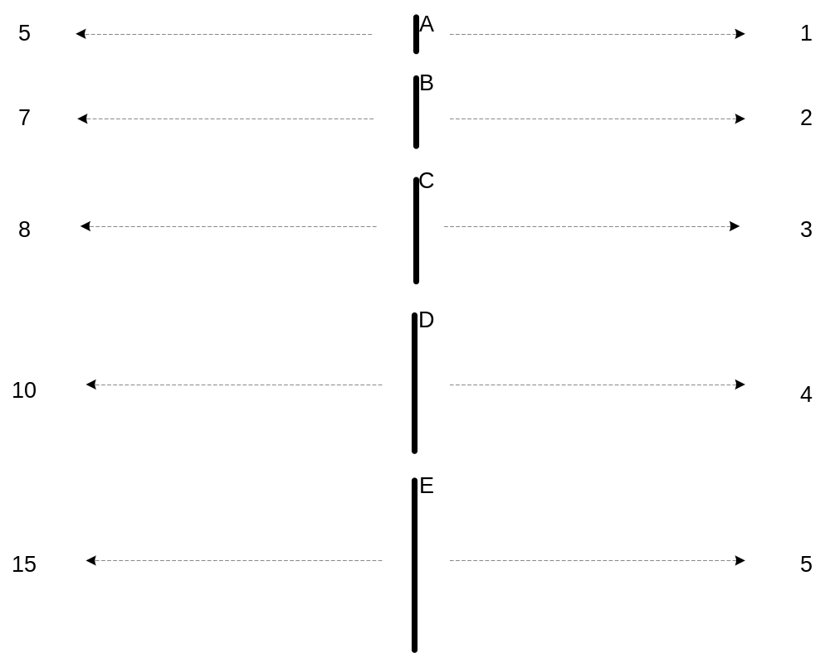
Measurement of Length
The way you measure an attribute may not match the attributes properties.
This scale preserves only the ordering property of length.
This scale preserves the ordering and additvity properties of length.

Slide 16
Attribute Values
Attribute values are numbers or symbols assigned to an attribute for a particular object
Distinction between attributes and attribute values
  Same attribute can be mapped to different attribute values
    Example: height can be measured in feet or meters
  Different attributes can be mapped to the same set of values
    Example: Attribute values for ID and age are integers
    But properties of attribute values can be different
The type of an attribute is determined by the set of possible values—nominal, binary, ordinal, or numeric—the attribute can have.

Slide 17
Types of Attributes
There are different types of attributes
  Categorical
    Examples: eye color, zip codes, words, rankings (e.g, good, fair, bad), height in {tall, medium, short}
    Nominal (no order or comparison) vs Ordinal (order but not comparable)
  Numeric
    Examples: dates, temperature, time, length, value, count.
    Discrete (counts) vs Continuous (temperature)
    Special case: Binary attributes (yes/no, exists/not exists)

Slide 18
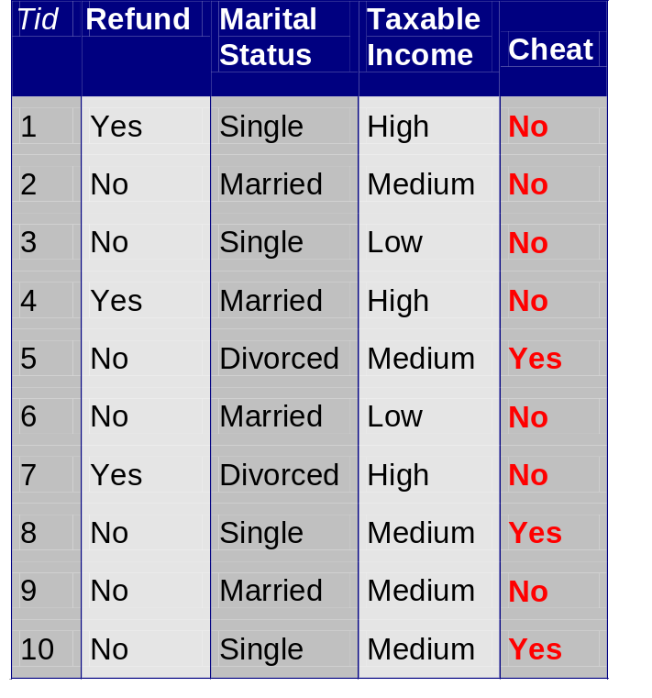
Categorical Data
Data that consists of a collection of records, each of which consists of a fixed set of categorical attributes

Slide 19
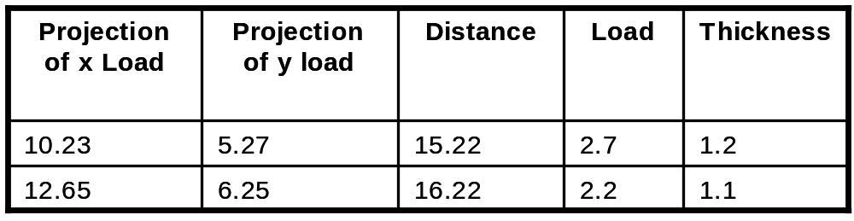
Numeric Record Data
If data objects have the same fixed set of numeric attributes, then the data objects can be thought of as points in a multi-dimensional space, where each dimension represents a distinct attribute
Such data set can be represented by an n-by-d data matrix, where there are n rows, one for each object, and d columns, one for each attribute

Slide 20
Types of Attributes
There are different types of attributes
  Nominal
    Examples: ID numbers, eye color, zip codes
  Ordinal
    Examples: rankings (e.g., taste of potato chips on a scale from 1-10), grades, height {tall, medium, short}
  Interval
    Examples: calendar dates, temperatures in Celsius or Fahrenheit.
  Ratio
    Examples: temperature in Kelvin, length, time, counts

Slide 21
Properties of Attribute Values
The type of an attribute depends on which of the following properties/operations it possesses:
  Distinctness: = ≠
  Order: < >
  Differences are + -
  meaningful :
  Ratios are * /
  meaningful
  Nominal attribute: distinctness
  Ordinal attribute: distinctness & order
  Interval attribute: distinctness, order & meaningful differences
  Ratio attribute: all 4 properties/operations

Slide 22
Difference Between Ratio and Interval
Is it physically meaningful to say that a temperature of 10 ° is twice that of 5° on
  the Celsius scale?
  the Fahrenheit scale?
  the Kelvin scale?
Consider measuring the height above average
  If Bill’s height is three inches above average and Bob’s height is six inches above average, then would we say that Bob is twice as tall as Bill?
  Is this situation analogous to that of temperature?

Slide 23
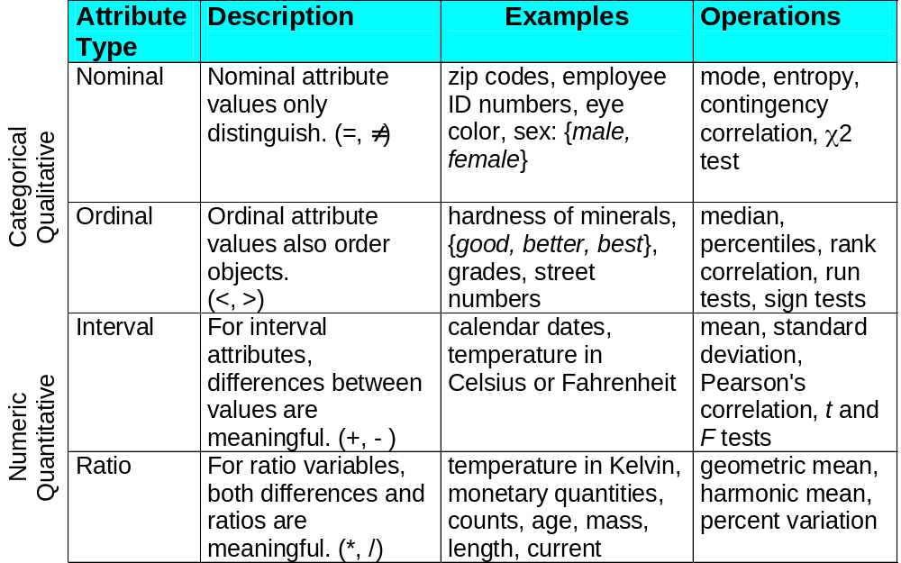
This categorization of attributes is due to S. S. Stevens

Slide 24
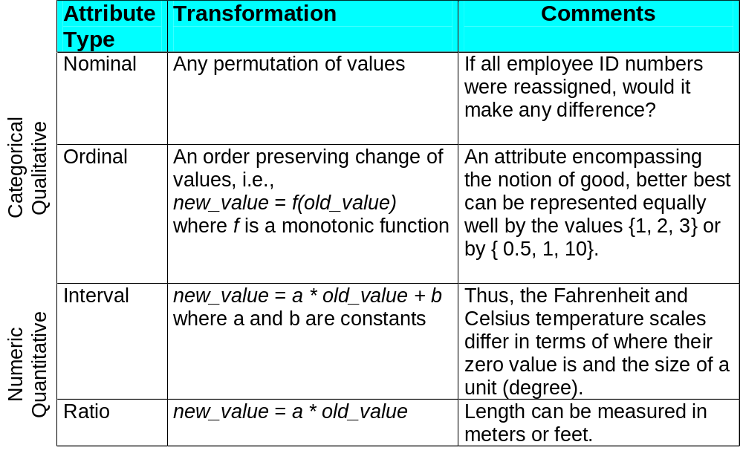
This categorization of attributes is due to S. S. Stevens

Slide 25
Describing Attributes by the Number of Values
  An independent way of distinguishing between attributes is by the number of values they can take.
Discrete Attribute
  Has only a finite or countably infinite set of values
  Examples: zip codes, counts, or the set of words in a collection of documents
  Often represented as integer variables.
  Note: binary attributes are a special case of discrete attributes
Continuous Attribute
  Has real numbers as attribute values
  Examples: temperature, height, or weight.
  Practically, real values can only be measured and represented using a finite number of digits.
  Continuous attributes are typically represented as floating-point variables.

Slide 26
Typically, nominal and ordinal attributes are binary or discrete, while interval and ratio attributes are continuous.
However, count attributes, which are discrete, are also ratio attributes.

Slide 27
Asymmetric Attributes
Only presence (a non-zero attribute value) is regarded as important
    Words present in documents
    Items present in customer transactions
If we met a friend in the grocery store would we ever say the following?
“I see our purchases are very similar since we didn’t buy most of the same things.”
We need two asymmetric binary attributes to represent one ordinary binary attribute
  Association analysis uses asymmetric attributes
Asymmetric attributes typically arise from objects that are sets

Slide 28
Key Messages for Attribute Types
The types of operations you choose should be “meaningful” for the type of data you have
  Distinctness, order, meaningful intervals, and meaningful ratios are only four properties of data
  The data type you see – often numbers or strings – may not capture all the properties or may suggest properties that are not there
  Analysis may depend on these other properties of the data
    Many statistical analyses depend only on the distribution
  Many times what is meaningful is measured by statistical significance
  But in the end, what is meaningful is measured by the domain

Slide 29
Attributes
Attribute (or dimensions, features, variables): a data field, representing a characteristic or feature of a data object.
  E.g., customer _ID, name, address
Types:
  Nominal
  Binary
  Numeric: quantitative
    Interval-scaled
    Ratio-scaled

Slide 30
Attribute Types
Nominal: categories, states, or “names of things”
  Hair_color = {auburn, black, blond, brown, grey, red, white}
  marital status, occupation, ID numbers, zip codes
Binary
  Nominal attribute with only 2 states (0 and 1)
  Symmetric binary: both outcomes equally important
    e.g., gender
  Asymmetric binary: outcomes not equally important.
    e.g., medical test (positive vs. negative)
    Convention: assign 1 to most important outcome (e.g., HIV positive)
Ordinal
  Values have a meaningful order (ranking) but magnitude between successive values is not known.
  Size = {small, medium, large}, grades, army rankings

Slide 31
Numeric Attribute Types
Quantity (integer or real-valued)
Interval
    Measured on a scale of equal-sized units
    Values have order
      E.g., temperature in C˚or F˚, calendar dates
    No true zero-point
Ratio
    Inherent zero-point
    We can speak of values as being an order of magnitude larger than the unit of measurement (10 K˚ is twice as high as 5 K˚).
      e.g., temperature in Kelvin, length, counts, monetary quantities

Slide 32
Discrete vs. Continuous Attributes
Discrete Attribute
  Has only a finite or countably infinite set of values
    E.g., zip codes, profession, or the set of words in a collection of documents
  Sometimes, represented as integer variables
  Note: Binary attributes are a special case of discrete attributes
Continuous Attribute
  Has real numbers as attribute values
    E.g., temperature, height, or weight
  Practically, real values can only be measured and represented using a finite number of digits
  Continuous attributes are typically represented as floating-point variables

Slide 33
Nominal Attributes
Nominal means “relating to names.” The values of a nominal attribute are symbols or names of things. Each value represents some kind of category, code, or state, and so nominal attributes are also referred to as categorical.
The values do not have any meaningful order.
In computer science, the values are also known as enumerations.
Example:
Suppose that hair color and marital status are two attributes describing person objects.
hair color are black, brown, blond, red, auburn, gray, and white.
marital status can take on the values single, married, divorced, and widowed.
Both hair color and marital status are nominal attributes.
Another example of a nominal attribute is occupation, with the values teacher, dentist, programmer, farmer, and so on.

Slide 34
Binary Attributes
A binary attribute is a nominal attribute with only two categories or states:
0 or 1, where 0 typically means that the attribute is absent, and 1 means that it is present.
Binary attributes are referred to as Boolean if the two states correspond to true and false.
Example: Given the attribute smoker describing a patient object, 1 indicates that the patient smokes, while 0 indicates that the patient does not. patient undergoes a medical test that has two possible outcomes.
The attribute medical test is binary, where a value of 1 means the result of the test for the patient is positive, while 0 means the result is negative.
A binary attribute is symmetric if both of its states are equally valuable and carry the same weight
Ex: Attribute gender having the states male and female.

Slide 35
Ordinal Attributes
An ordinal attribute is an attribute with possible values that have a meaningful order or ranking among them, but the magnitude between successive values is not known.
Example : Suppose that drink size corresponds to the size of drinks available at a fast-food restaurant.
This nominal attribute has three possible values: small, medium, and large. The values have a meaningful sequence (which corresponds to increasing drink size); however, we cannot tell from the values how much bigger, say, a medium is than a large.
Other examples of ordinal attributes include grade (e.g., A+, A, A-, B+, and so on) and professional rank.
Professional ranks can be enumerated in a sequential order: for example, assistant, associate, and full for professors, and private, private first class, specialist, corporal, and sergeant for army ranks.

Slide 36
Ordinal attributes are useful for registering subjective assessments of qualities that cannot be measured objectively; thus ordinal attributes are often used in surveys for ratings.
In one survey, participants were asked to rate how satisfied they were as customers.
Customer satisfaction had the following ordinal categories: 0: very dissatisfied, 1: somewhat dissatisfied, 2: neutral, 3: satisfied, and 4: very satisfied.
Nominal, Binary, and Ordinal attributes are qualitative. i.e., they describe a feature of an object without giving an actual size or quantity.
The values of such qualitative attributes are typically words representing categories.
If integers are used, they represent computer codes for the categories, as opposed to measurable quantities
(e.g., 0 for small drink size, 1 for medium, and 2 for large)

Slide 37
Numeric Attributes
A numeric attribute is quantitative; that is, it is a measurable quantity, represented in integer or real values.
Numeric attributes can be interval-scaled or ratio-scaled.
Interval-Scaled Attributes: Interval-scaled attributes are measured on a scale of equal-size units. The values of interval-scaled attributes have order and can be positive, 0, or negative.
Thus, in addition to providing a ranking of values, such attributes allow us to compare and quantify the difference between values.
Example : A temperature attribute is interval-scaled. Suppose that we have the outdoor temperature value for a number of different days, where each day is an object. By ordering the values, we obtain a ranking of the objects with respect to temperature.
In addition, we can quantify the difference between values. For example, a temperature of 20C is five degrees higher than a temperature of 15C.
Calendar dates are another example. For instance, the years 2002 and 2010 are eight years apart.
Because interval-scaled attributes are numeric, compute their mean value, in addition to the median and mode measures of central tendency.

Slide 38
Ratio-Scaled Attributes
A ratio-scaled attribute is a numeric attribute with an inherent zero-point. That is, if a measurement is ratio-scaled, we can speak of a value as being a multiple (or ratio) of another value.
In addition, the values are ordered, and we can also compute the difference between values, as well as the mean, median, and mode.
Example: Unlike temperatures in Celsius and Fahrenheit, the Kelvin (K) temperature scale has what is considered a true zero-point (0⁰K = -273.15⁰C):
It is the point at which the particles that comprise matter have zero kinetic energy.
Other examples of ratio-scaled attributes include count attributes such as years of experience (e.g., the objects are employees) and number of words (e.g., the objects are documents).
Additional examples include attributes to measure weight, height, latitude and longitude coordinates (e.g., when clustering houses), and monetary quantities (e.g., you are 100 times richer with $100 than with $1).

Slide 39
Discrete versus Continuous Attributes
Classification algorithms developed from the field of machine learning often talk of attributes as being either discrete or continuous. Each type may be processed differently.
A discrete attribute has a finite or countably infinite set of values, which may or may not be represented as integers.
The attributes hair color, smoker, medical test, and drink size each have a finite number of values, and so are discrete.
Note that discrete attributes may have numeric values, such as 0 and 1 for binary attributes or, the values 0 to 110 for the attribute age.
An attribute is countably infinite if the set of possible values is infinite but the values can be put in a one-to-one correspondence with natural numbers.
For example, the attribute customer ID is countably infinite.
The number of customers can grow to infinity, but in reality, the actual set of values is countable (where the values can be put in one-to-one correspondence with the set of integers).
Zip codes are another example.

Slide 40
Continuous Attribute
If an attribute is not discrete, it is continuous.
The terms numeric attribute and continuous attribute are often used interchangeably in the literature.
(This can be confusing because, in the classic sense, continuous values are real numbers, whereas numeric values can be either integers or real numbers.)
In practice, real values are represented using a finite number of digits.
Continuous attributes are typically represented as floating-point variables.

Slide 41


Types of Data Sets
Record
  Relational records
  Data matrix, e.g., numerical matrix, crosstabs
  Document data: text documents: term-frequency vector
  Transaction data
Graph and network
  World Wide Web
  Social or information networks
  Molecular Structures
Ordered
  Video data: sequence of images
  Temporal data: time-series
  Sequential Data: transaction sequences
  Genetic sequence data
Spatial, image and multimedia:
  Spatial data: maps
  Image data:
  Video data:

Slide 42
Important Characteristics of Data
  Dimensionality (number of attributes)
    High dimensional data brings a number of challenges
  Sparsity
    Only presence counts
  Resolution
    Patterns depend on the scale
  Size
    Type of analysis may depend on size of data
-- Distribution
  . Centrality and dispersion

Slide 43

Record Data
Data that consists of a collection of records, each of which consists of a fixed set of attributes

Slide 44
Transaction Data
A special type of record data, where
  Each record (transaction) involves a set of items.
  For example, consider a grocery store. The set of products purchased by a customer during one shopping trip constitute a transaction, while the individual products that were purchased are the items.

Slide 45
Data Matrix
If data objects have the same fixed set of numeric attributes, then the data objects can be thought of as points in a multi-dimensional space, where each dimension represents a distinct attribute
Such data set can be represented by an m by n matrix, where there are m rows, one for each object, and n columns, one for each attribute

Slide 46
The Sparse Data Matrix
A sparse data matrix is a special case of a data matrix in which the attributes are of the same type and are asymmetric; i.e., only non-zero values are important.
Transaction data is an example of a sparse data matrix that has only 0, 1 entries.
Another common example is document data. In particular, if the order of the terms (words) in a document is ignored, then a document can be represented as a term vector, where each term is a component (attribute) of the vector and the value of each component is the number of times the corresponding term occurs in the document.
This representation of a collection of documents is often called a document-term matrix.
Figure 2.2(d) shows a sample document-term matrix.
The documents are the rows of this matrix, while the terms are the columns. In practice, only the non-zero entries of sparse data matrices are stored.

Slide 47
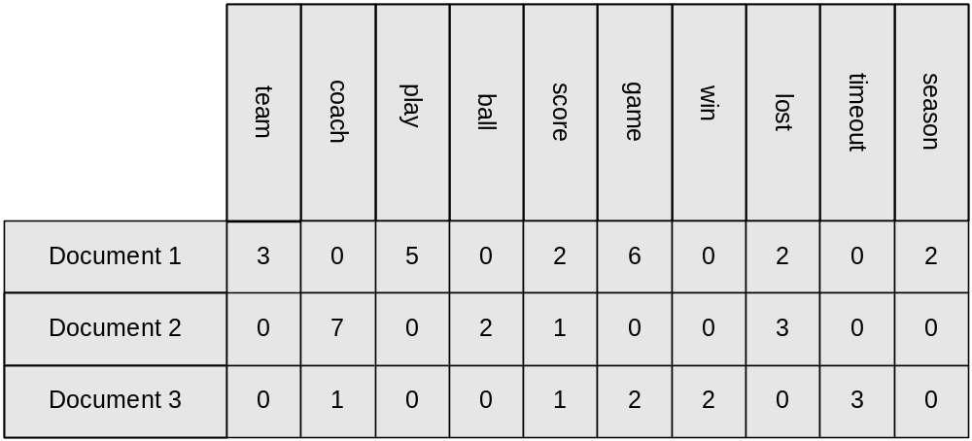
Document Data
Each document becomes a ‘term’ vector
  Each term is a component (attribute) of the vector
  The value of each component is the number of times the corresponding term occurs in the document.

Slide 48
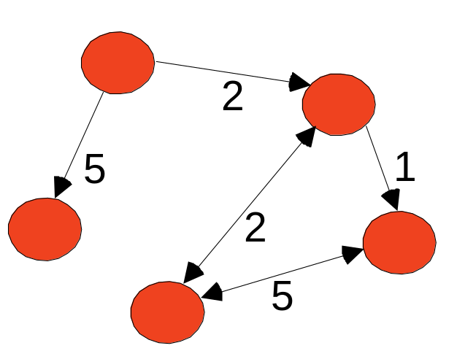
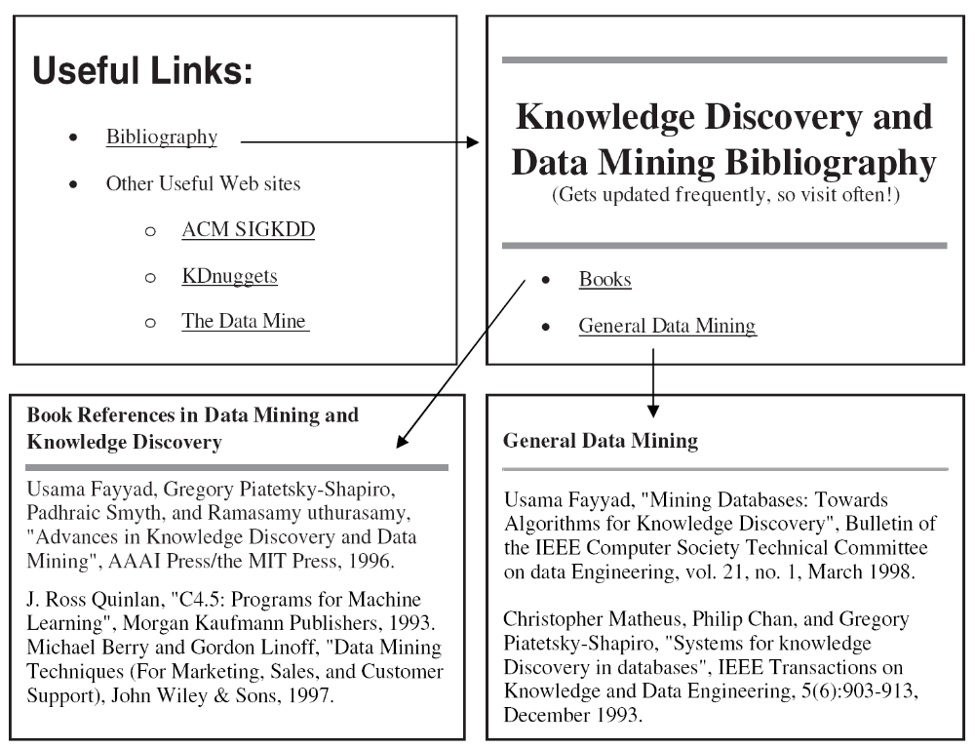
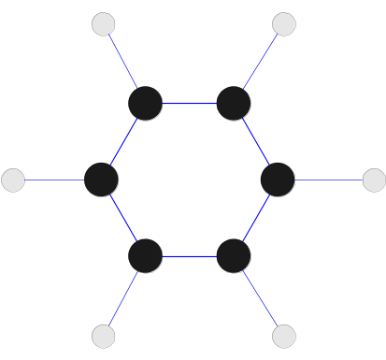
Graph Data
Examples: Generic graph, a molecule, and webpages
Benzene Molecule: C6H6

Slide 49
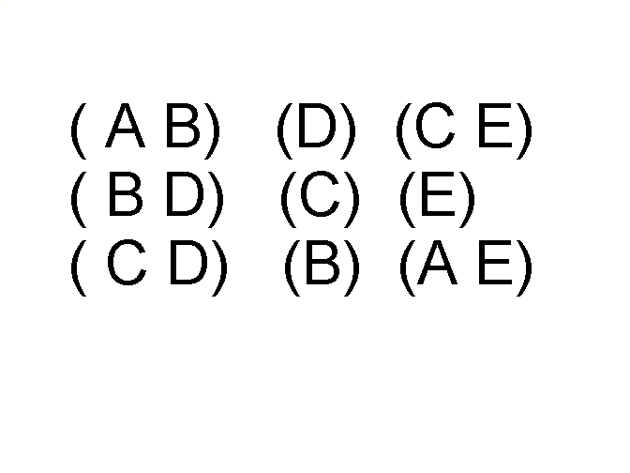
Ordered Data
Sequences of transactions
Items/Events
An element of the sequence

Slide 50
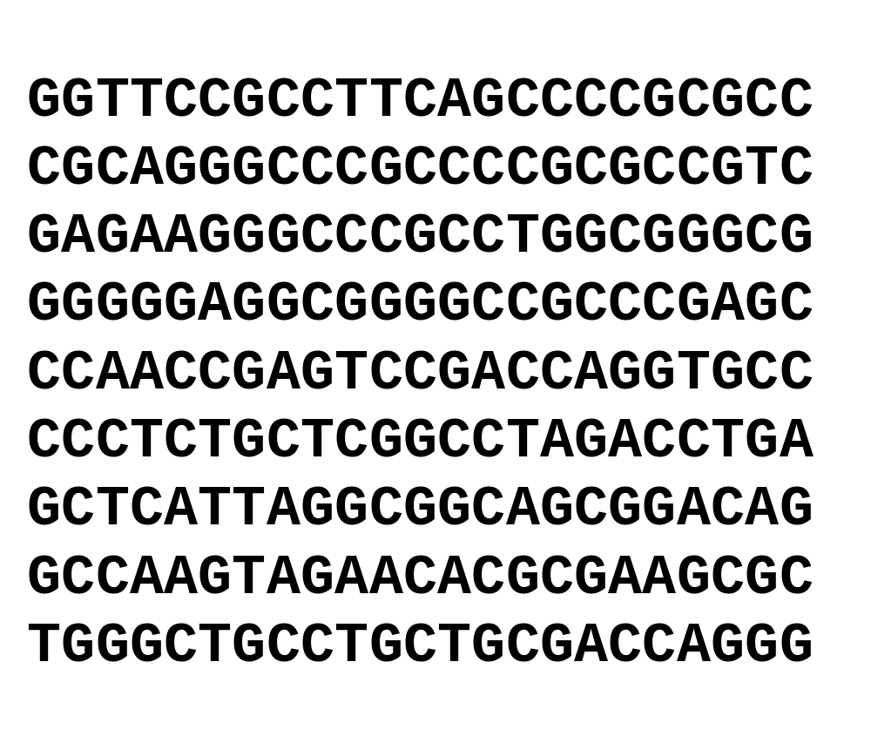
Ordered Data
Genomic sequence data

Slide 51
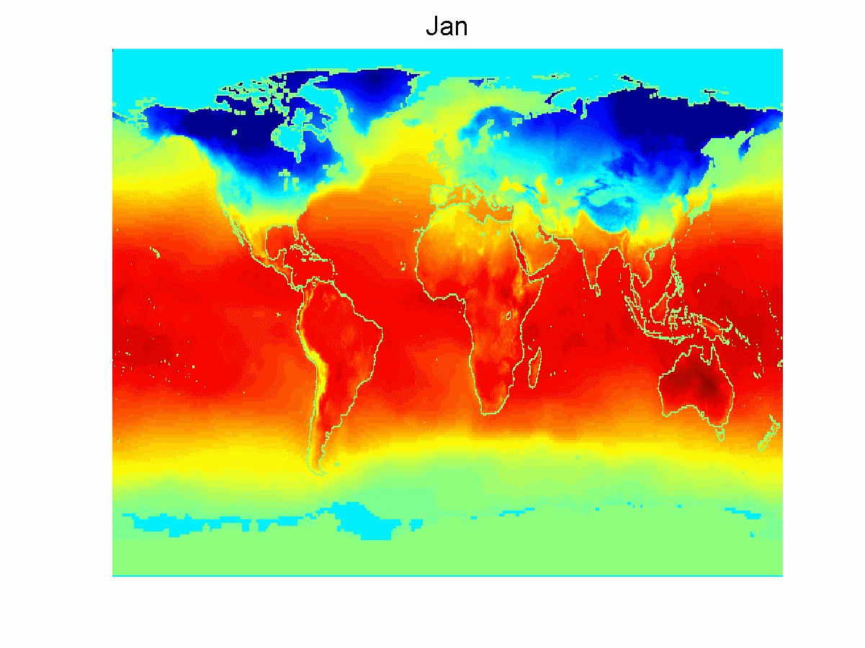
Ordered Data
Spatio-Temporal Data
Average Monthly Temperature of land and ocean

Slide 52
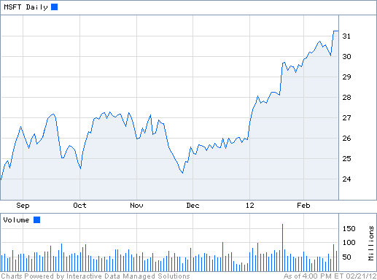
Ordered Data
Time series
  Sequence of ordered (over “time”) numeric values.

Slide 53
Handling Non-Record Data
Most data mining algorithms are designed for record data or its variations, such as transaction data and data matrices.
Record-oriented techniques can be applied to non-record data by extracting features from data objects and using these features to create a record corresponding to each object.
Consider the chemical structure data that was described earlier.
Given a set of common substructures, each compound can be represented as a record with binary attributes that indicate whether a compound contains a specific substructure.
Such a representation is actually a transaction data set, where the transactions are the compounds and the items are the substructures.
In some cases, it is easy to represent the data in a record format, but this type of representation does not capture all the information in the data.

Slide 54
Consider spatio-temporal data consisting of a time series from each point on a spatial grid.
This data is often stored in a data matrix, where each row represents a location and each column represents a particular point in time.
However, such a representation does not explicitly capture the time relationships that are present among attributes and the spatial relationships that exist among objects.
This does not mean that such a representation is inappropriate, but rather that these relationships must be taken into consideration during the analysis.
For example, it would not be a good idea to use a data mining technique that assumes the attributes are statistically independent of one another.

Slide 55
Data Quality
Poor data quality negatively affects many data processing efforts
“The most important point is that poor data quality is an unfolding disaster.
  Poor data quality costs the typical company at least ten percent (10%) of revenue; twenty percent (20%) is probably a better estimate.”
Thomas C. Redman, DM Review, August 2004
Data mining example: a classification model for detecting people who are loan risks is built using poor data
  Some credit-worthy candidates are denied loans
  More loans are given to individuals that default

Slide 56
Data Quality …
What kinds of data quality problems?
How can we detect problems with the data?
What can we do about these problems?
Examples of data quality problems:
  Noise and outliers
  Missing values
  Duplicate data
  Wrong data

Slide 57
Measurement and Data Collection Issues
It is unrealistic to expect that data will be perfect. There may be problems due to human error, limitations of measuring devices, or flaws in the data collection process. Values or even entire data objects may be missing.
Spurious or duplicate objects; i.e., multiple data objects that all correspond to a single "real" object.
For ex: there might be two different records for a person who has recently lived at two different addresses. Even if all the data is present and "looks fine," there may be inconsistencies-a person has a height of 2 meters, but weighs only 2 kilograms.
Focus on aspects of data quality that are related to data measurement and collection.
Definition of measurement and data collection errors and consider a variety of problems that involve measurement error: noise, artifacts, bias, precision, and accuracy.
Conclude by discussing data quality issues that may involve both measurement and data collection problems: outliers, missing and inconsistent values, and duplicate data.

Slide 58


Noise
For objects, Noise is an extraneous object
For attributes, noise refers to modification of original values
  Examples: distortion of a person’s voice when talking on a poor phone and “snow” on television screen
Two Sine Waves
Two Sine Waves + Noise

Slide 59

OUTLIERS
Outliers are data objects with characteristics that are considerably different than most of the other data objects in the data set
  Case 1: Outliers are
  noise that interferes
  with data analysis
  Case 2: Outliers are
  the goal of our analysis
    Credit card fraud
    Intrusion detection
Causes?

Slide 60
Missing Values
Reasons for missing values
  Information is not collected
  (e.g., people decline to give their age and weight)
  Attributes may not be applicable to all cases
  (e.g., annual income is not applicable to children)
Handling missing values
  Eliminate data objects or variables
  Estimate missing values
    Example: time series of temperature
    Example: census results
  Ignore the missing value during analysis

Slide 61
Missing Values …
Missing Completely At Random (MCAR)
  Missingness of a value is independent of attributes
  Fill in values based on the attribute
  Analysis may be unbiased overall
Missing At Random (MAR)
  Missingness is related to other variables
  Fill in values based other values
  Almost always produces a bias in the analysis
Missing Not At Random (MNAR)
  Missingness is related to unobserved measurements
  Informative or non-ignorable missingness
Not possible to know the situation from the data

Slide 62
DUPLICATE DATA
Data set may include data objects that are duplicates, or almost duplicates of one another
  Major issue when merging data from heterogeneous sources
Examples:
  Same person with multiple email addresses
Data cleaning
  Process of dealing with duplicate data issues
When should duplicate data not be removed?

Slide 63
Measurement and Data Collection Errors
The term measurement error refers to any problem resulting from the measurement process.
A common problem is that the value recorded differs from the true value to some extent.
For continuous attributes, the numerical difference of the measured and true value is called the error.
The term data collection error refers to errors such as omitting data objects or attribute values, or inappropriately including a data object.
Ex: a study of animals of a certain species might include animals of a related species that are similar in appearance to the species of interest.
Both measurement errors and data collection errors can be either systematic or random.
Within particular domains, there are certain types of data errors that are commonplace, and there often exist well-developed techniques for detecting and/or correcting these errors.
Ex: keyboard errors are common when data is entered manually, and as a result, many data entry programs have techniques for detecting and, with human intervention, correcting such errors.

Slide 64
Precision, Bias, and Accuracy
In statistics and experimental science, the quality of the measurement process and the resulting data are measured by precision and bias.
Provide the standard definitions, followed by a brief discussion.
For the following definitions, let us assume that and make repeated measurements of the same underlying quantity and use this set of values to calculate a mean (average) value that serves as estimate of the true value.
Precision: The closeness of repeated measurements (of the same quantity) to one another.
Bias: A systematic quantity being measured.

Slide 65
Precision is often measured by the standard deviation of a set of values, while Bias is measured by taking the difference between the mean of the set of values and the known value of the quantity being measured.
Bias can only be determined for objects whose measured quantity is known by means external to the current situation.
Suppose that we have a standard laboratory weight with a mass of 1g and want to assess the precision and bias of our new Laboratory scale.
Weigh the mass five times, and obtain the following five values: {1.015,0.9901,. 0131, .001,0.986}.
The mean of these values is 1.001, and hence, the bias is 0.001. The precision, as measured by the standard deviation, is 0.013.
Accuracy is to refer to the degree of measurement error in data.

Slide 66
Accuracy
The closeness of measurements to the true value of the quantity being measured.
Accuracy depends on precision and bias, but since it is a general concept, there is no specific formula for accuracy in terms of these two quantities.
One important aspect of accuracy is the use of significant digits.
The goal is to use only as many digits to represent the result of a measurement or calculation as are justified by the precision of the data. Ex: if the Iength of an object is measured with a meter stick whose smallest markings are millimeters, then only record the length of data to the nearest millimeter.
The precision of such a measurement would be ± 0.5mm.
Do not review the details of working with significant digits.

Slide 67
DATA OBJECTS
Data sets are made up of data objects.
A data object represents an entity.
Examples:
  Sales Database: customers, store items, sales
  Medical Database: patients, treatments
  University Database: students, professors, courses
Also called samples , examples, instances, data points, objects, tuples.
Data objects are described by Attributes.
Database rows -> data objects;
columns ->attributes.

Slide 68
What is Data?
Collection of data objects and their attributes
An attribute is a property or characteristic of an object
  Examples: eye color of a person, temperature, etc.
  Attribute is also known as variable, field, characteristic, dimension, or feature
A collection of attributes describe an object
  Object is also known as record, point, case, sample, entity, or instance
Attributes
Objects

Slide 69
A More Complete View of Data
Data may have parts
The different parts of the data may have relationships
Data may have structure
Data can be incomplete

Slide 70
The data is also very complex
Multiple types of data: tables, time series, images, graphs, etc
Spatial and temporal aspects
Interconnected data of different types:
  From the mobile phone we can collect, location of the user, friendship information, check-ins to venues, opinions through twitter, images though cameras, queries to search engines

Slide 71

Example: transaction data
Billions of real-life customers:
  WALMART: 20M transactions per day
  AT&T 300 Million calls per day
  Credit card companies: billions of transactions per day.
The point cards allow companies to collect information about specific users

Slide 72
Example: document data
Web as a document repository: estimated 50 billions of web pages
Wikipedia: 4 million articles (and counting)
Online news portals: steady stream of 100’s of new articles every day
Twitter: ~300 million tweets every day

Slide 73
Example: network data
Web: 50 billion pages linked via hyperlinks
Facebook: 500 million users
Twitter: 300 million users
Instant messenger: ~1billion users
Blogs: 250 million blogs worldwide, presidential candidates run blogs

Slide 74
Example: genomic sequences
http://www.1000genomes.org/page.php
Full sequence of 1000 individuals
3*10⁹ nucleotides per person → 3*10¹² nucleotides
Lots more data in fact: medical history of the persons, gene expression data

Slide 75
Example: environmental data
Climate data (just an example)
  http://www.ncdc.gov/oa/climate/ghcn-monthly/index.php
“a database of temperature, precipitation and pressure records managed by the National Climatic Data Center, Arizona State University and the Carbon Dioxide Information Analysis Center”
“6000 temperature stations, 7500 precipitation stations, 2000 pressure stations”
  Spatiotemporal data

Slide 76
Behavioral data
Mobile phones today record a large amount of information about the user behavior
  GPS records position
  Camera produces images
  Communication via phone and SMS
  Text via facebook updates
  Association with entities via check-ins
Amazon collects all the items that you browsed, placed into your basket, read reviews about, purchased.
Google and Bing record all your browsing activity via toolbar plugins. They also record the queries you asked, the pages you saw and the clicks you did.
Data collected for millions of users on a daily basis

Slide 77
Quality of the Data
Most of data mining techniques can tolerate some level of imperfection in the data, a focus on understanding and improving data quality typically improves the quality of the resulting analysis.
Data quality issues that often need to be addressed include the presence of noise and outliers; missing, inconsistent, or duplicate data; and data that is biased or, in some other way, unrepresentative of the phenomenon or population that the data is supposed to describe.

Slide 78
Types of data
Numeric data: Each object is a point in a multidimensional space
Categorical data: Each object is a vector of categorical values
Set data: Each object is a set of values (with or without counts)
  Sets can also be represented as binary vectors, or vectors of counts
Ordered sequences: Each object is an ordered sequence of values.
Graph data

Slide 79

What can you do with the data?
Suppose that you are the owner of a supermarket and you have collected billions of market basket data. What information would you extract from it and how would you use it?
What if this was an online store?
Product placement
Catalog creation
Recommendations

Slide 80
What can you do with the data?
Suppose you are a search engine and you have a toolbar log consisting of
  pages browsed,
  queries,
  pages clicked,
  ads clicked
each with a user id and a timestamp. What information would you like to get our of the data?
Ad click prediction
Query reformulations

Slide 81
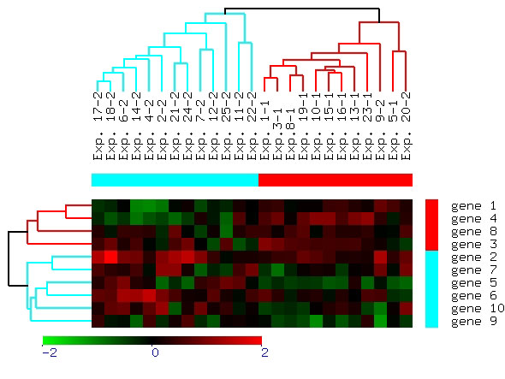
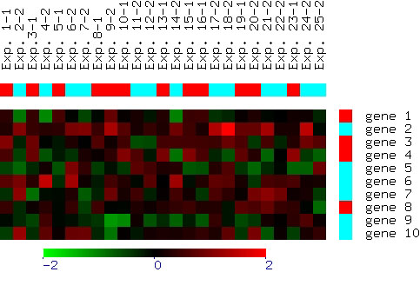
What can you do with the data?
Suppose you are biologist who has microarray expression data: thousands of genes, and their expression values over thousands of different settings (e.g. tissues). What information would you like to get out of your data?
Groups of genes and tissues

Slide 82
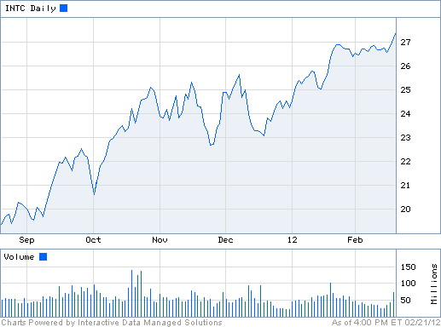
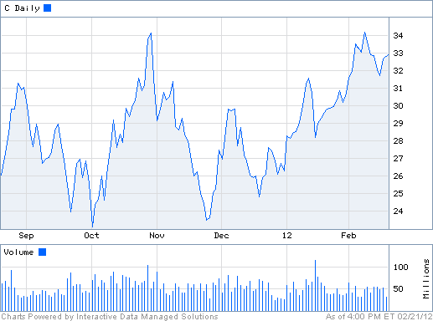
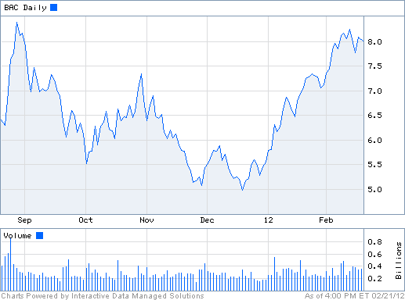
What can you do with the data?
Suppose you are a stock broker and you observe the fluctuations of multiple stocks over time. What information would you like to get our of your data?
Clustering of stocks
Correlation of stocks
Stock Value prediction

Slide 83
What can you do with the data?
You are the owner of a social network, and you have full access to the social graph, what kind of information do you want to get out of your graph?
Who is the most important node in the graph?
What is the shortest path between two nodes?
How many friends two nodes have in common?
How does information spread on the network?

Slide 84
Some Extensions and Critiques
Velleman, Paul F., and Leland Wilkinson. "Nominal, ordinal, interval, and ratio typologies are misleading." The American Statistician 47, no. 1 (1993): 65-72.
Mosteller, Frederick, and John W. Tukey. "Data analysis and regression. A second course in statistics." Addison-Wesley Series in Behavioral Science: Quantitative Methods, Reading, Mass.: Addison-Wesley, 1977.
Chrisman, Nicholas R. "Rethinking levels of measurement for cartography."Cartography and Geographic Information Systems 25, no. 4 (1998): 231-242.

Slide 85
Critiques
Incomplete
  Asymmetric binary
  Cyclical
  Multivariate
  Partially ordered
  Partial membership
  Relationships between the data
Real data is approximate and noisy
  This can complicate recognition of the proper attribute type
  Treating one attribute type as another may be approximately correct

Slide 86
Critiques …
Not a good guide for statistical analysis
  May unnecessarily restrict operations and results
    Statistical analysis is often approximate
    Thus, for example, using interval analysis for ordinal values may be justified
  Transformations are common but don’t preserve scales
    Can transform data to a new scale with better statistical properties
    Many statistical analyses depend only on the distribution

Slide 87
More Complicated Examples
ID numbers
  Nominal, ordinal, or interval?
Number of cylinders in an automobile engine
  Nominal, ordinal, or ratio?
Biased Scale
  Interval or Ratio

